Slide 1
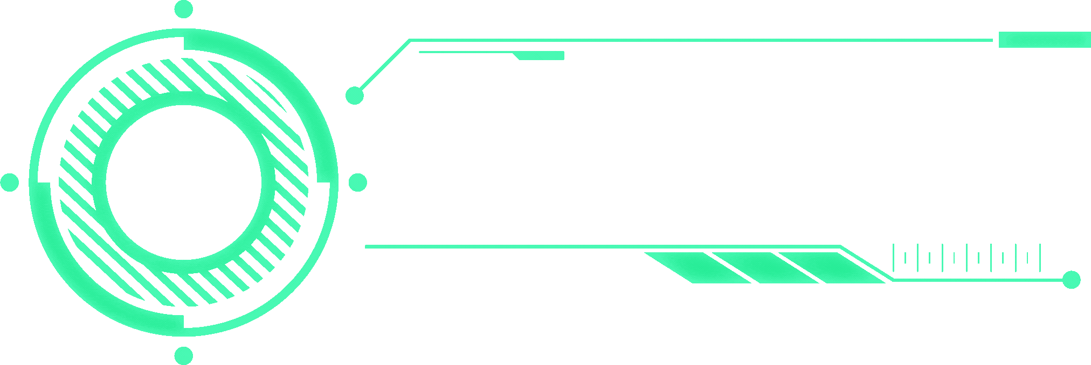

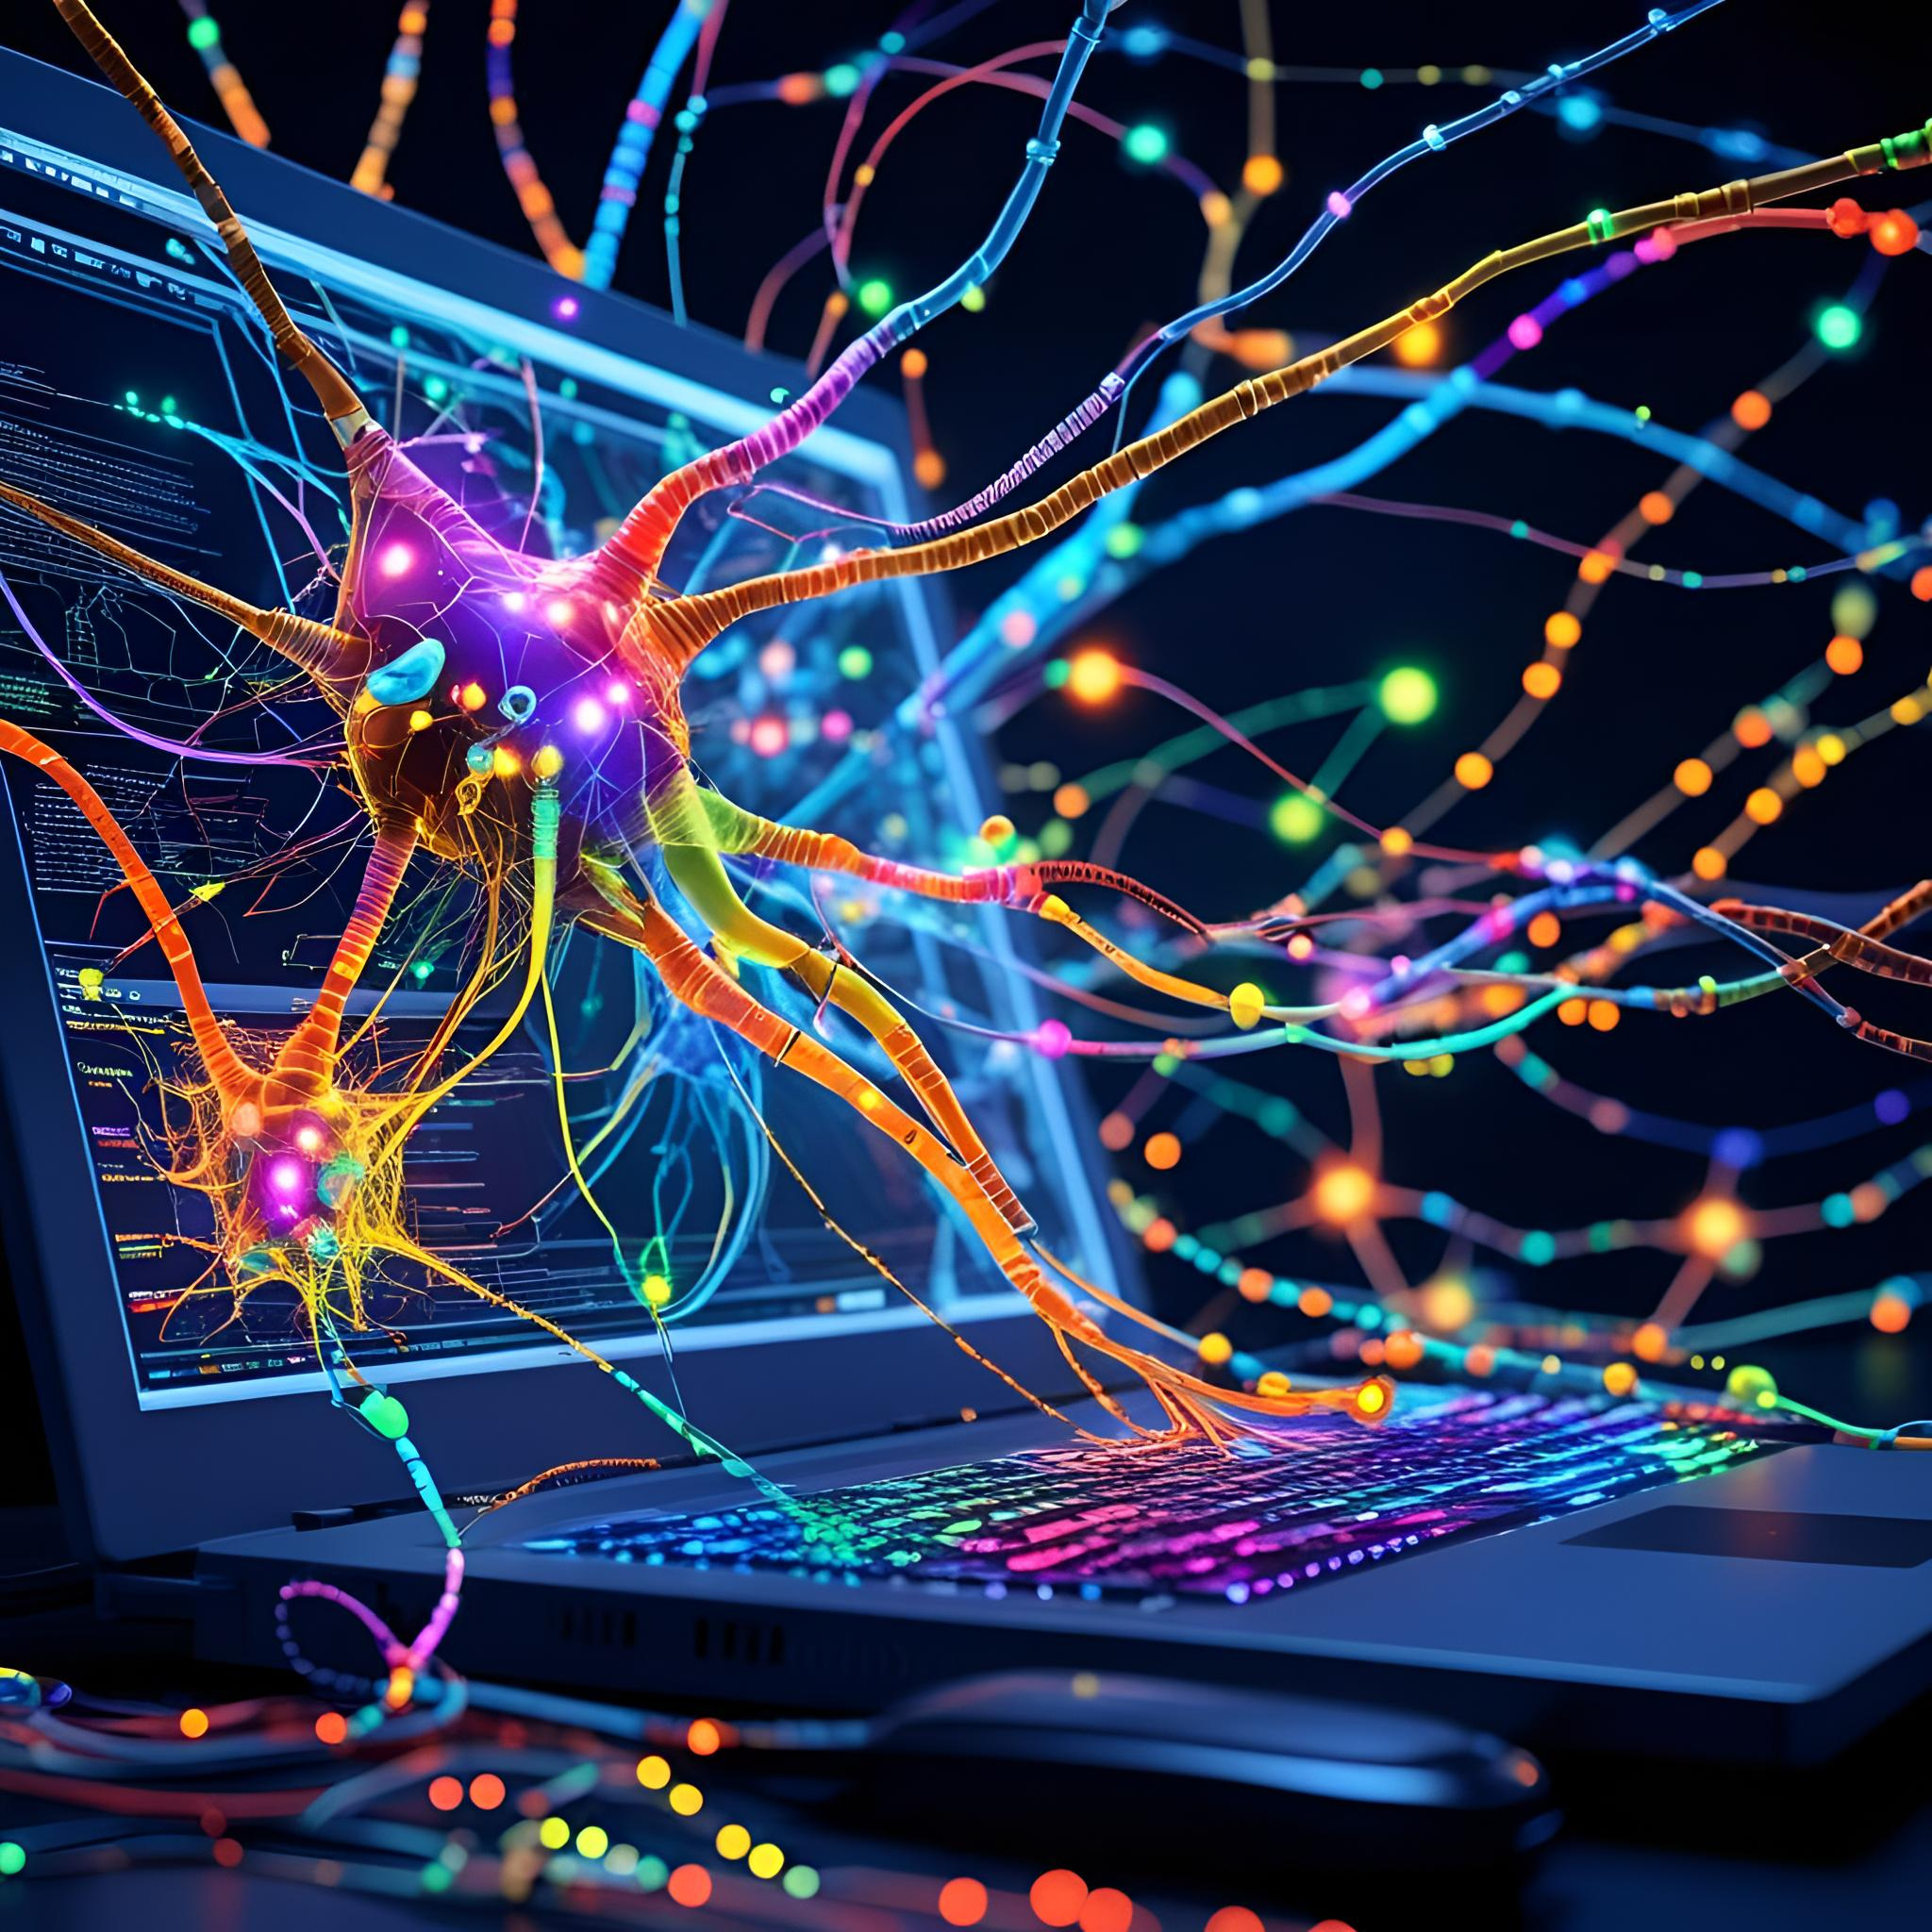

Home
About Us
Contact
Implementation of
multilayer Perceptron
Course :Connectionist Networks
Members:
Academic Info
Ahmadou Tidiane Ndongo
Djibril Sow
Faly Beydary Ndiaye
Alassane Kane
Master 1 GDIL/R2SD
2024 - 2025
next slide

Slide 2


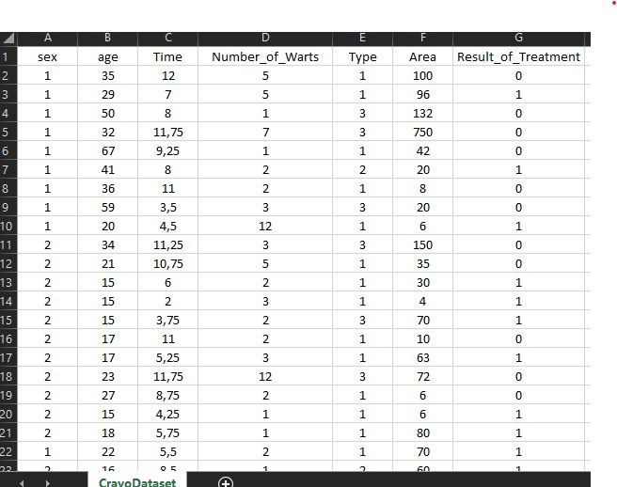
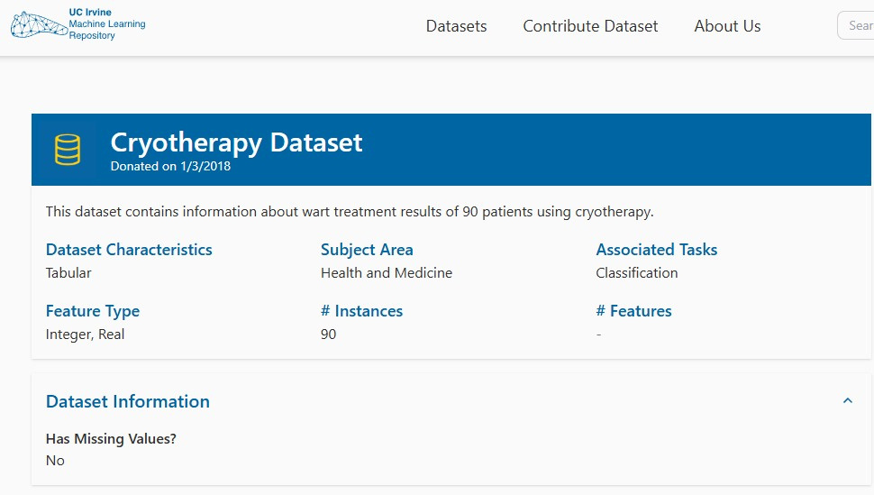
Dataset
Home
About Us
Contact
connectionist Networks
next slide

Slide 3

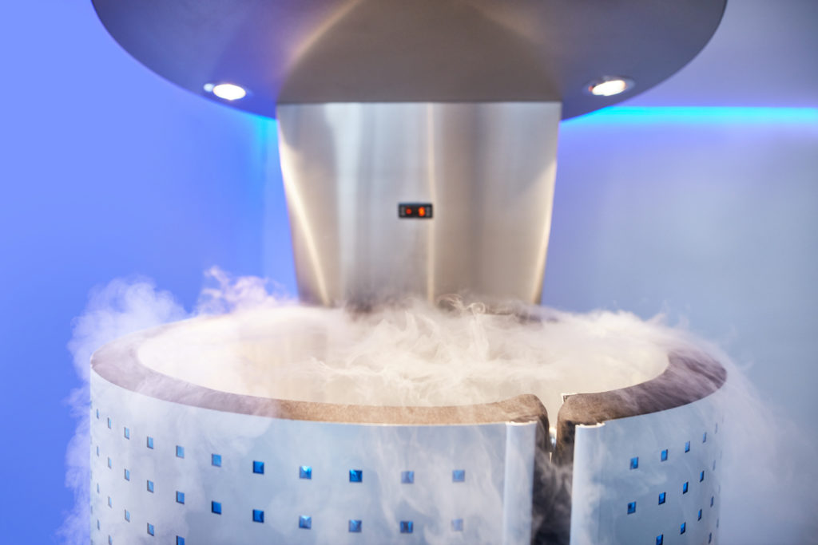
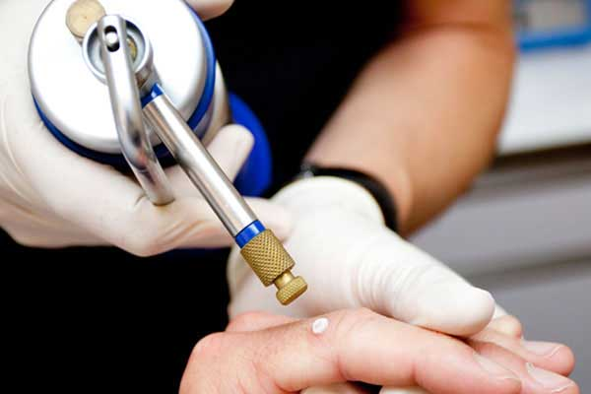
Studio Shodwe
Home
About Us
Contact
What is Cryotherapy?
A medical treatment that uses extreme cold to destroy abnormal tissues
next slide

Slide 4




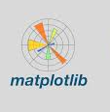
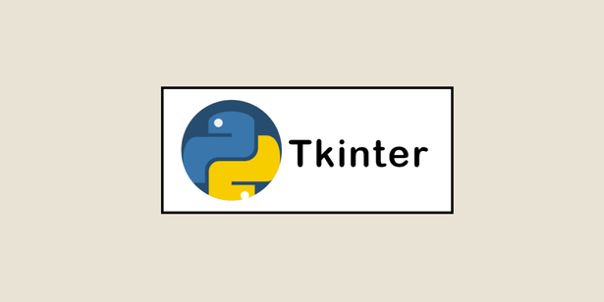

Tools & Libraries Used
Home
About Us
Contact
Programming Language::
next slide

Slide 5
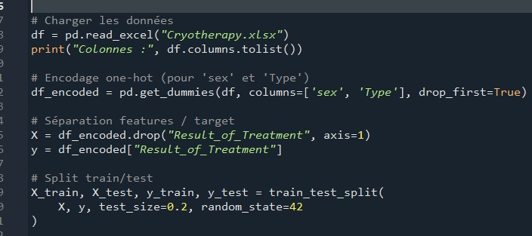
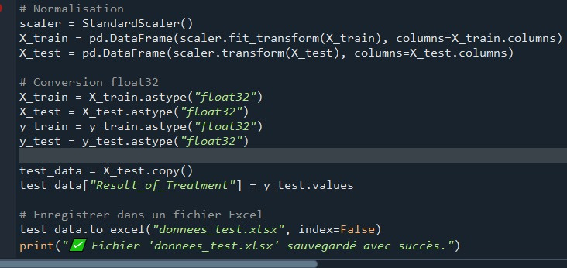
Home
About Us
Contact
Preprocessing Workflow
Import the dataset using Pandas
(Cryotherapy.xlsx).
Split data into Training (80%) and Testing (20%) sets
Normalize features using StandardScaler .
Save processed files:
training_data.xlsx and test_data.xlsx.
next slide

Slide 6
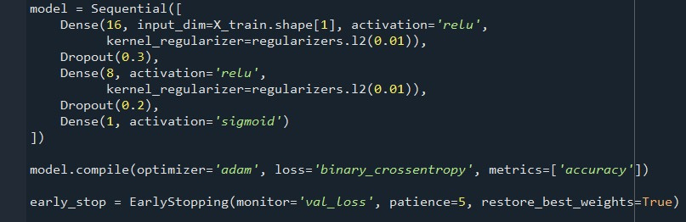
Home
About Us
Contact
Perceptron
Structure
Input Layer: 7 neurons (one for each feature).
Hidden Layer 1: Dense(16, ReLU)
Hidden Layer 2: Dense(8, ReLU)
Output Layer: Dense(1, Sigmoid) for binary classification
next slide

Slide 7
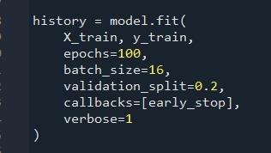
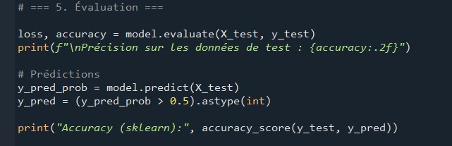
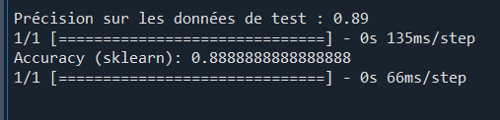
History Tracking
Home
About Us
Contact
Training the model with 100 epochs
Using batch size of 16 and 20% validation split
Early stopping callback to prevent overfitting
next slide

Slide 8
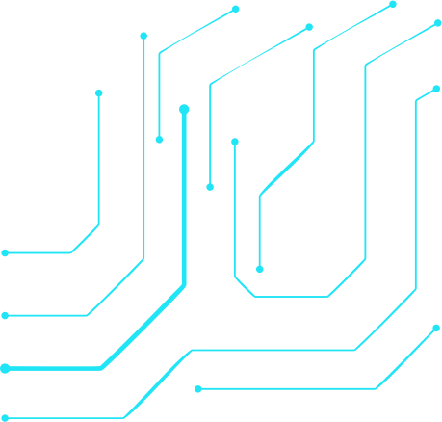
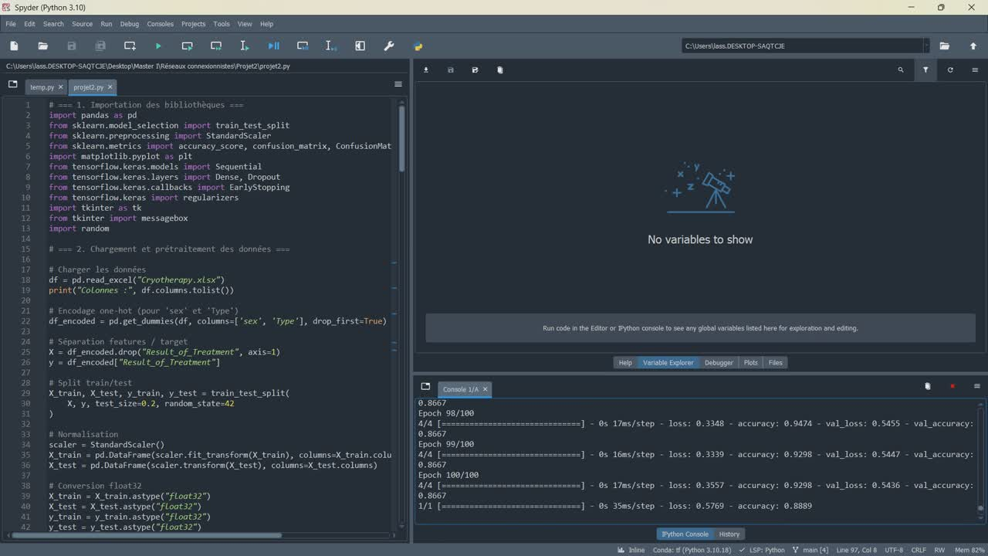
Results
Home
About Us
Contact
next slide

Slide 9
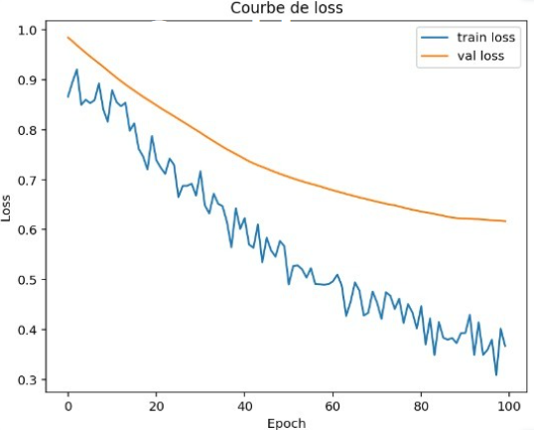
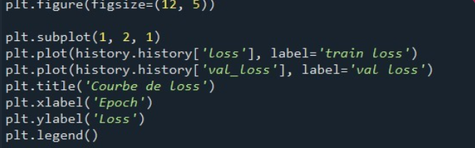
Graphics
Home
About Us
Contact
how the model's error (loss) decreases
over epochs for training and validation
connectionist Networks
next slide

Slide 10
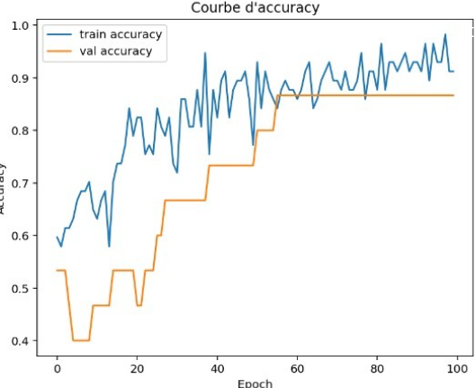
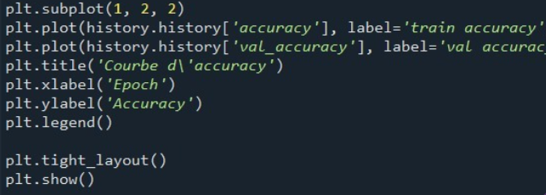
Graphics
how the model’s prediction accuracy improves
over epochs for training and validation
connectionist Networks
next slide

Slide 11
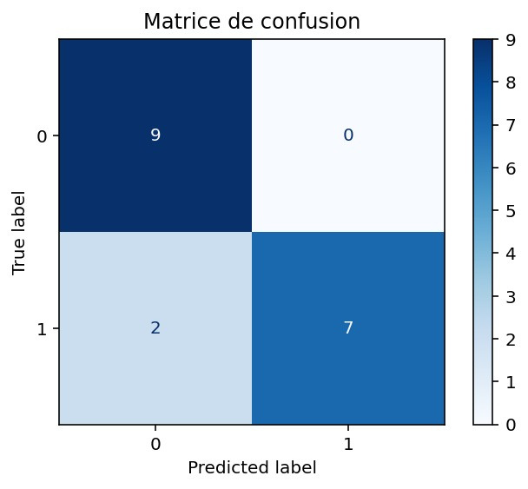
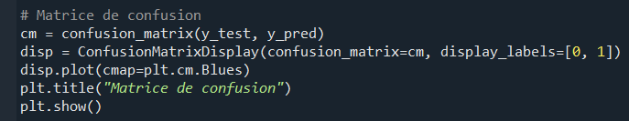
Graphics
the number of correct and incorrect
predictions for each class (0 or 1)
connectionist Networks
next slide

Slide 12
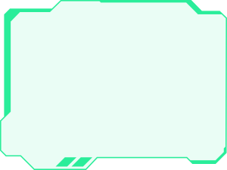
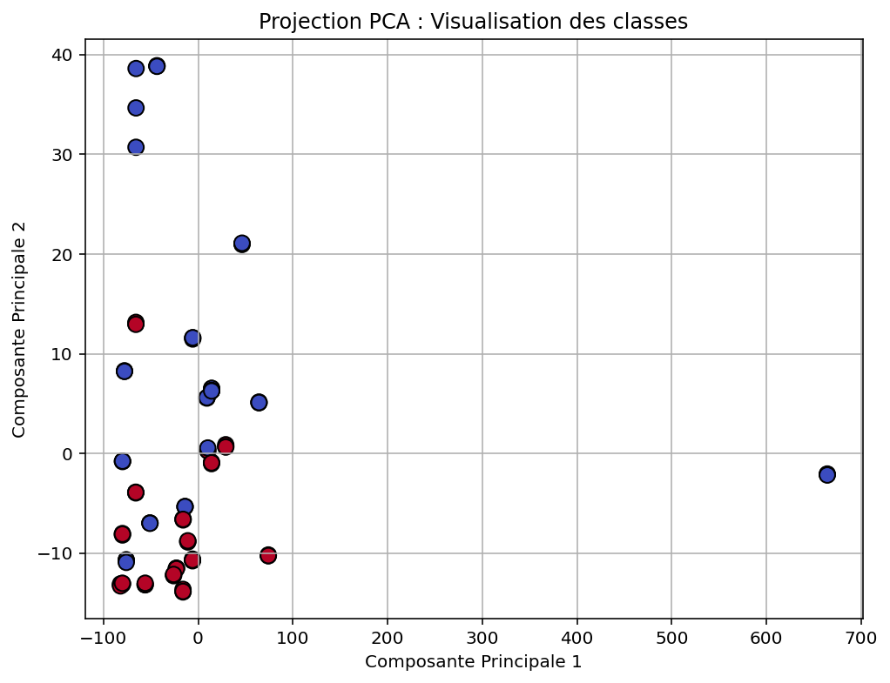

Graphics
Home
About Us
Contact
next slide

Slide 13
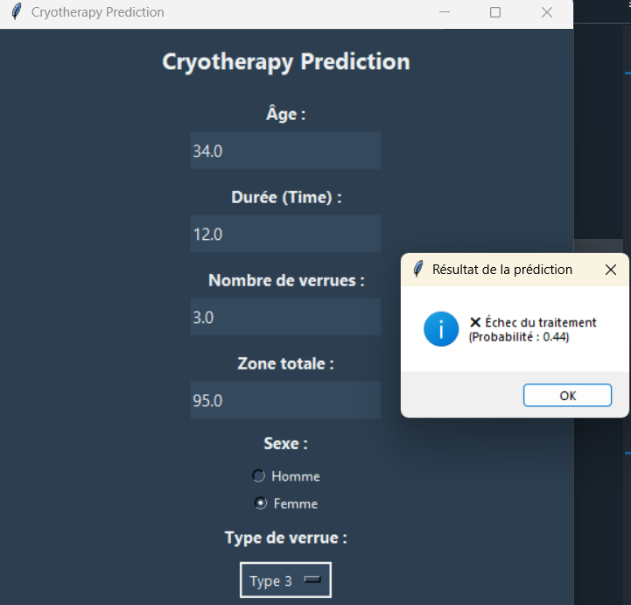


Graphical User Interface
Home
About Us
Contact
next slide

Slide 14
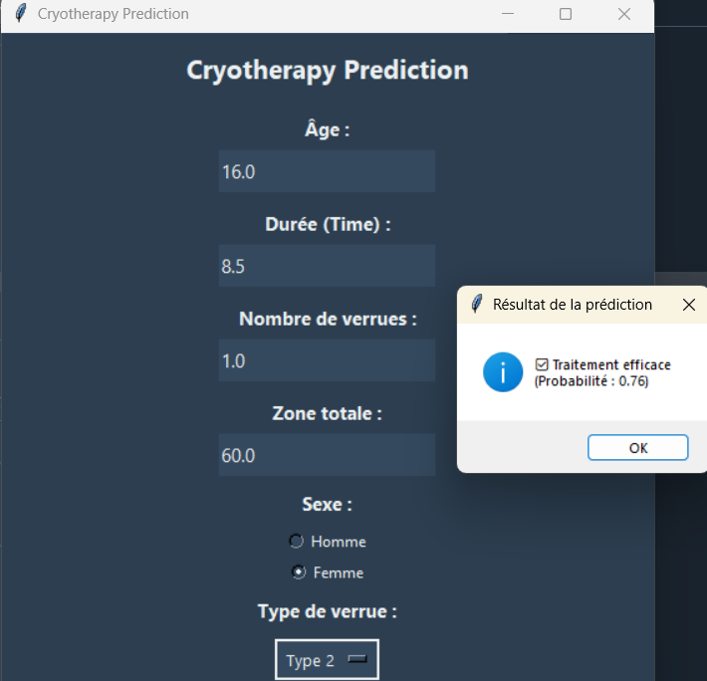
Graphical User Interface
Home
About Us
Contact
next slide

Slide 15
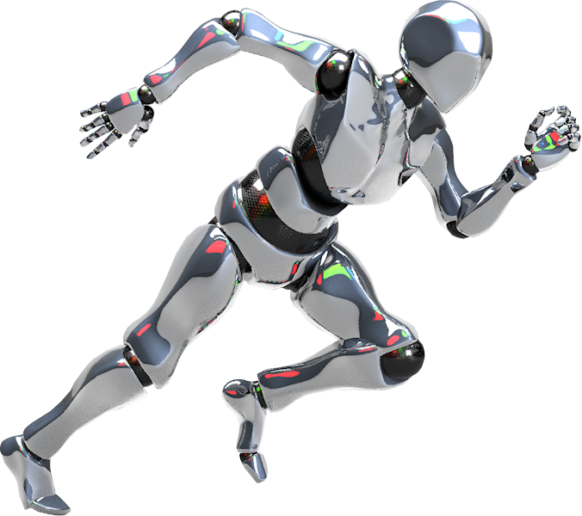
Home
About Us
Contact
Thank You!
connectionist Networks
end slide

